Slide 1

Spatial Correlation of Highest Energy Cosmic Rays with Galaxies in Local Universe
Hajime Takami
Institute for the Physics and Mathematics of the Universe,
the University of Tokyo
Ref.
HT, T.Nishimichi, K.Yahata, K.Sato, JCAP 06 (2009) 031
HT, K.Sato, arXiv:0909.1532

Slide 2
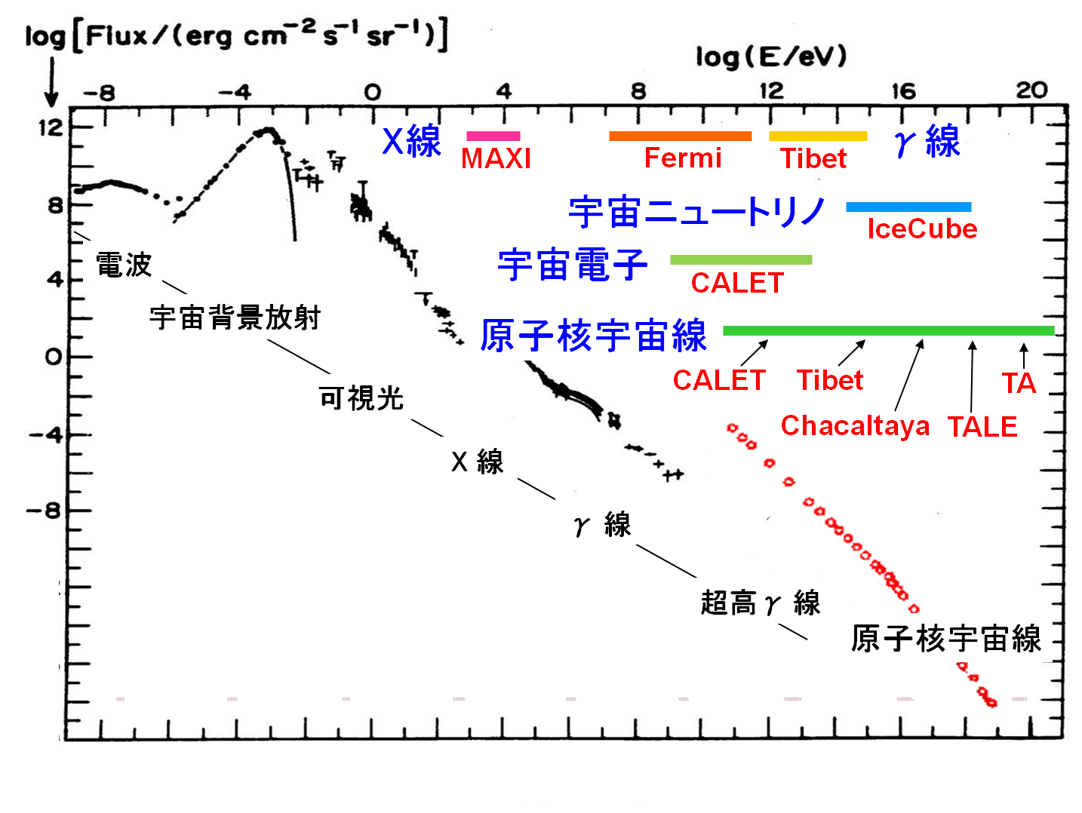
Highest Energy Cosmic Rays
Extremely small flux
~ 1 event km⁻² century⁻¹
@10²⁰eV
radio
Very large detectors
CMB
AGASA (~1300 km² yr sr)
HiRes (~2000 km² yr sr)
Auger (~13000 km² yr sr)
TA (~1000 km² yr sr)
log (flux)
optical
X-rays
∝E^{-2.7}
γ-rays
VHE γ-rays
∝E⁻³
Cosmic rays
Sources: unknown
extragalactic
Source Candidates
GRBs
AGNs
Magnetars
Cluster of galaxies
What is the sources of HECRs?

Slide 3
Observables and Current Results
Energy spectrum
Arrival direction distribution --- anisotropy
Chemical Composition
Suppression @ ~10²⁰eV
(HiRes, Auger)
Extension beyond 10²⁰eV
(AGASA)
Correlation with EG objects
(Auger)
No Correlation
(HiRes)
Heavy-nuclei dominated
(Auger)
Proton dominated
(HiRes)
More statistics is expected to resolve these inconsistency.

Slide 4
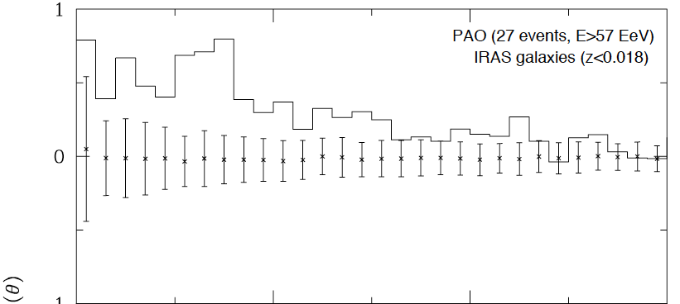
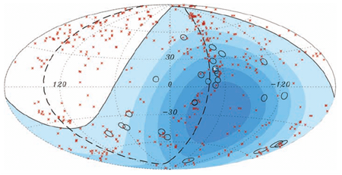
Correlation with Extragalactic Universe
with AGNs in a catalog
with LSS
E>5.7x10¹⁹eV, ψ<3.1º, z<0.018
w(θ)
Abraham et al. 2007
0
5
10
15
20
25
30
Angular Separation [deg]
HT et al. 2009
HECR sources are, at least, extragalactic objects
Deflection angles of HECRs are within ~15º
2 events correlate with the nearest radio-loud AGN (Cen A)

Slide 5
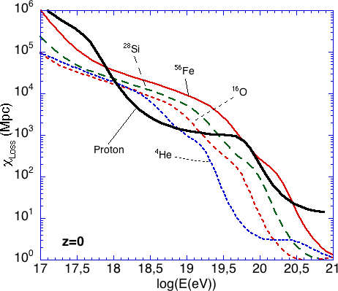
GZK Mechanism
Highest energy cosmic rays cannot reach the Earth from distant sources
Cosmic rays above 6x10¹⁹eV at the Earth had more energies at their sources
pγ_{CMB} ➔ πX
Nγ_{CMB} ➔ p(N-1)
HECRs can come from sources typically within 100Mpc for protons or irons
Allard 2006

Slide 6
Deflection by GMF/IGMF
Main component of HECRs is charged particles
HT et al. 2006
GMF/IGMF weaken possible correlation
Notes:
No14

Slide 7
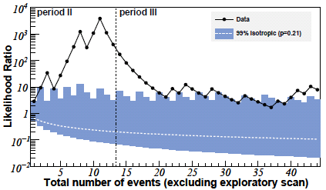
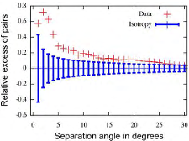
Motivations
Can we search for HECR sources by HECRs themselves?
Are deflections small?
How is the composition of HECRs?
Which is the AGN correlation, true one or fake one?
Abraham et al. 2009
PAO 2009
We consider the effect of GMF in detail.

Slide 8
Magnetic Field in Spiral Galaxies
Observing extragalactic edge-on and face-on galaxies
In the disk
spiral field strong at optical arm - axisymmetric (AS) / bisymmetric (BS)
turbulent component (0.5-2 x spiral) strong at interarm region
In the halo
spiral component parallel to a galactic disk
magnetic fields perpendicular to the disk
Parker loops?, dipole field?, galactic-wind induced B-fields
For our Galaxy
spiral field strong at optical arm – AS or BS? is still controversial
z-components observed at around the solar system and Galactic center
no direct evidence of the loops, dipole, and GW B-fields

Slide 9
GMF Models
AS: No reversal
S-parity (parallel)
exp. decay
x
BS: reversals for every arm
Galactic Plane
A-parity (anti-parallel)
4 different GMF models are treated fairly.
Alvarez-Muniz & Stanev 2006

Slide 10
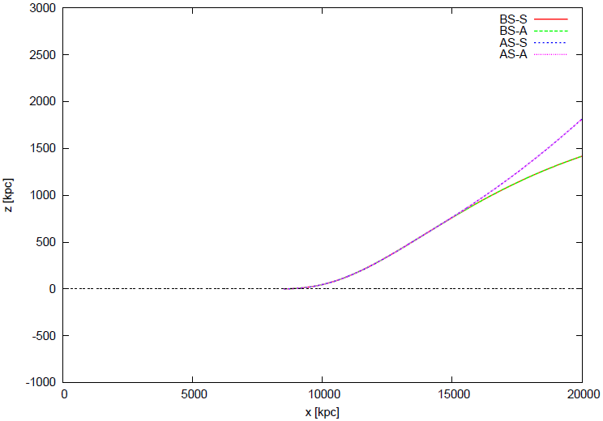
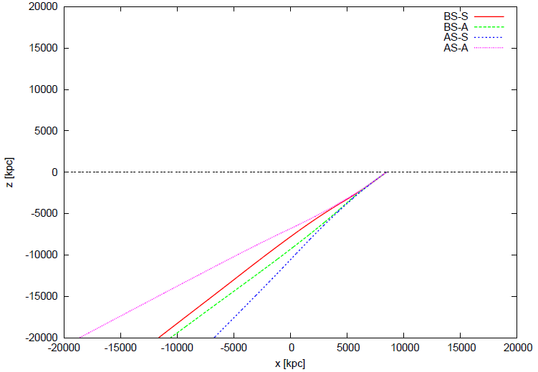
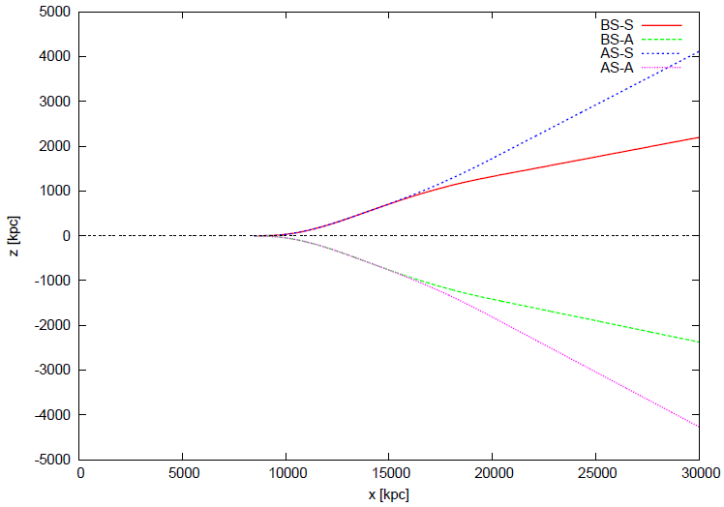
Examples of HECR Trajectories
Earth
BS-S
BS-A
AS-S
AS-A
BS
Galactic Center
AS
z [kpc]
z [kpc]
x [kpc]
BS-S
AS-A
BS
S
AS
BS-A
AS-S
A
x [kpc]
z [kpc]
The trajectories of protons are affected by the nearest field reversals of GMF.
BS-A
AS-S
S
A
BS-S
AS-A
x [kpc]

Slide 11
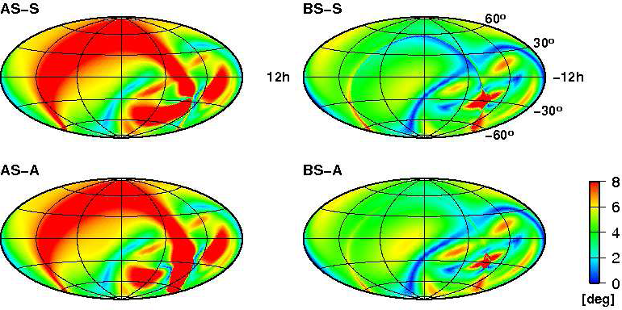
Deflection of Protons by GMF
E_{p}=10^{19.8}eV=6.3x10¹⁹eV
The pattern of HEP deflection angles is quite different between the AS and BS models, which depends on field reversals.
The difference is more prominent in the northern sky.

Slide 12
Simulation
Set models
Source model
Sources are distributed following LSS actually observed
All sources emit HE protons persistently with the same power
The number density of HECR sources, n_{s}, is 10⁻⁴ or 10⁻⁵Mpc⁻³
Injection spectrum is ∝E^{-2.6}
Consider 100 source distribution for each n_{s}
Cosmic magnetic fields : the 4 GMF models
Calculate one arrival distribution of protons from a source distribution taking the propagation of protons in Galactic space into account.
Calculate a cross-correlation function between the simulated events and their sources.
3. is repeated 100 times and we calculate the average and variance of the 100 cross-correlation functions.

Slide 13
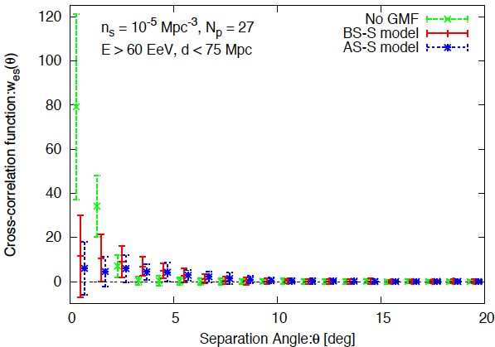
Effect of GMF to correlation
Auger aperture
GMF suppresses a correlation signal.

Slide 14
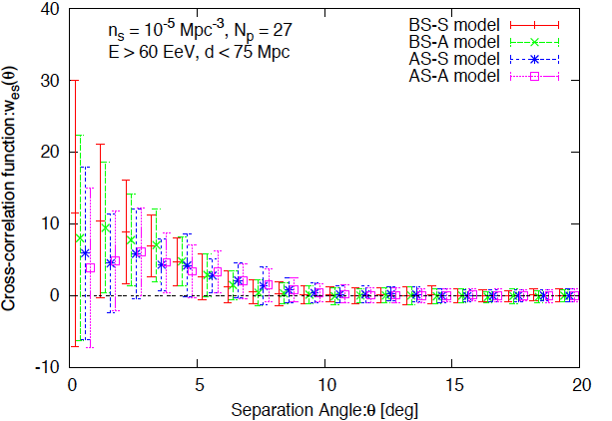
Status in 2007
Auger aperture
BS-S
BS-A
AS-S
AS-A
Predictions by the AS models are consistent with no correlation in considering ~1σ error.

Slide 15
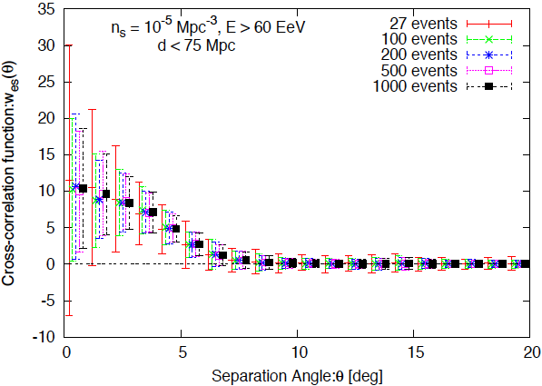
Uncertainty/errors
Errors due to the finite number of events ➔ reducible by accumulating events
Errors due to the positional uncertainty of sources ➔ not reducible
BS-S
The total errors are saturated at ~200 protons accumulation

Slide 16
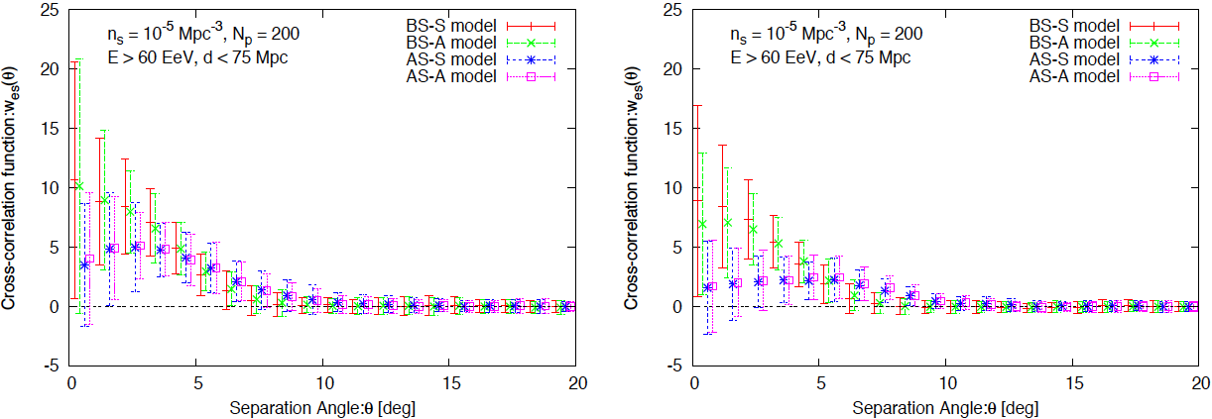
Forecast in the Near Future
South
North
Southern sky
Basically correlation with HEPs is predicted
The angular scale of the correlation is different between the BS and AS models
Northern sky
Significance of the correlation for the AS models is quite low

Slide 17
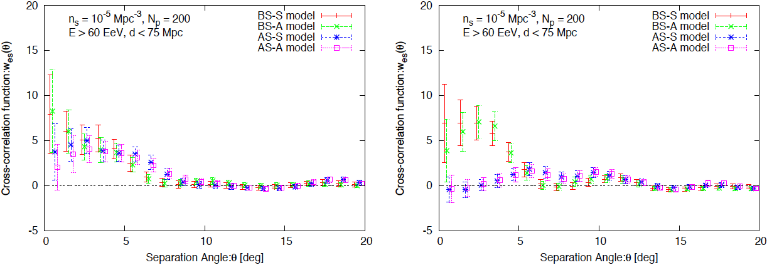
Correlation Signal from a Source Distribution
South
North

Slide 18
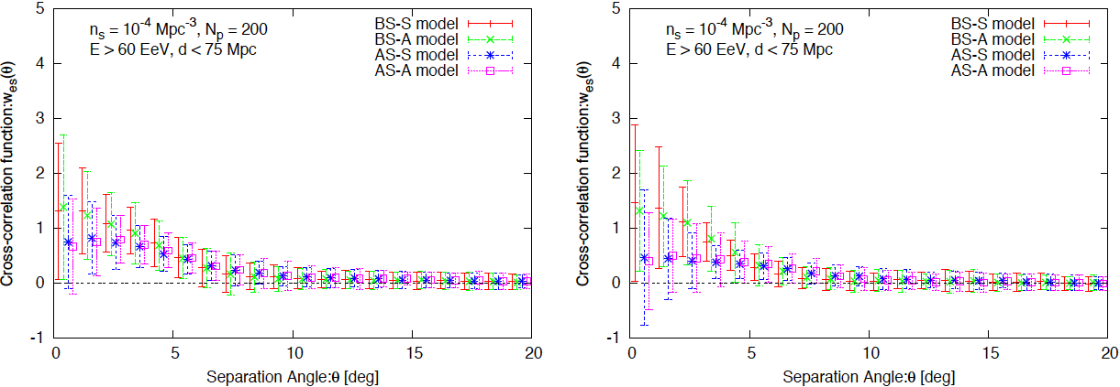
For 10⁻⁴Mpc⁻³
South
North
Basic features are unchanged compared to the case of 10⁻⁵Mpc⁻³, though the significance of the correlation decreases.

Slide 19
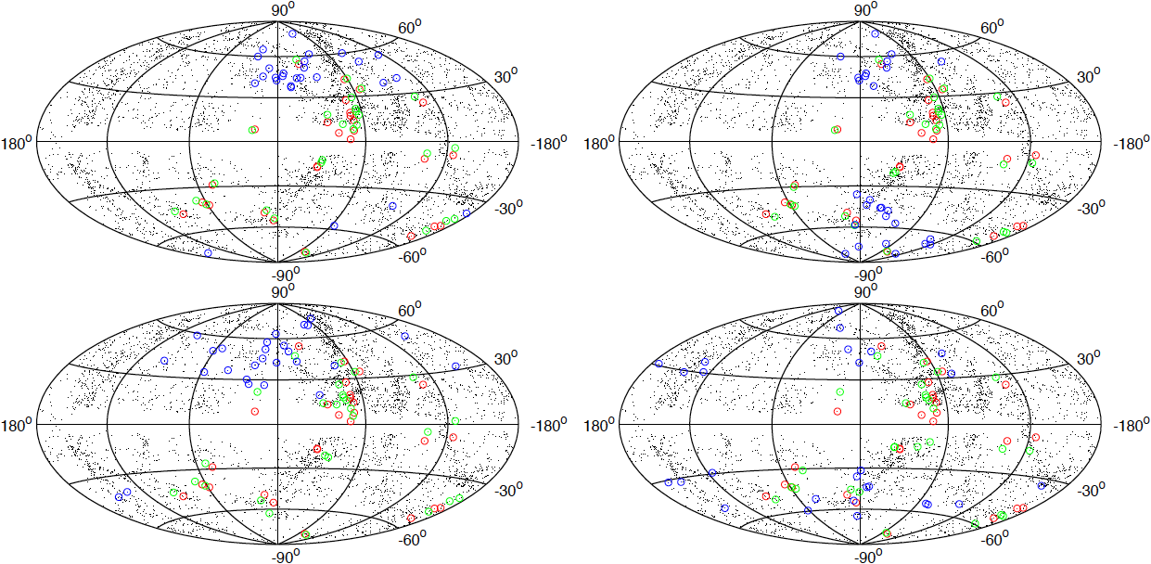
Protons/Irons deflection
○ : original Auger events, ○ : source positions for protons, ○ : sources positions for irons
BS-S
BS-A
AS-S
AS-A
HT & Sato 2009
Pure-iron composition disturbs the correlation of HECRs and matter distribution

Slide 20
Summary
We discuss whether the proton component of HECRs can unveil their sources.
The signal of correlation between HEPs and their sources depends on GMF models, especially on field reversals. The dependence is higher in the northern terrestrial hemisphere.
There is the possibility that the current AGN correlation (in 2007) is fake.
After 200 protons accumulation, the protons unveil their sources with sufficient significance in many cases. If the AS GMF model is realized in the Universe, the correlation might not be observed in the northern sky.
Pure-iron composition is not preferred in the viewpoint of the arrival distribution. A significant fraction of light nuclei (or protons) is expected to be included in cosmic rays at highest energies.

